Slide 1
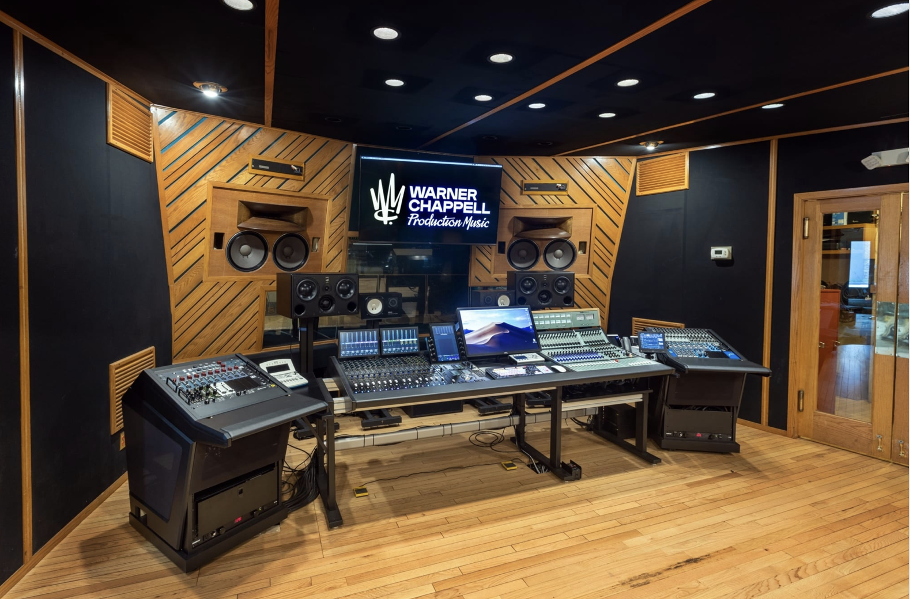
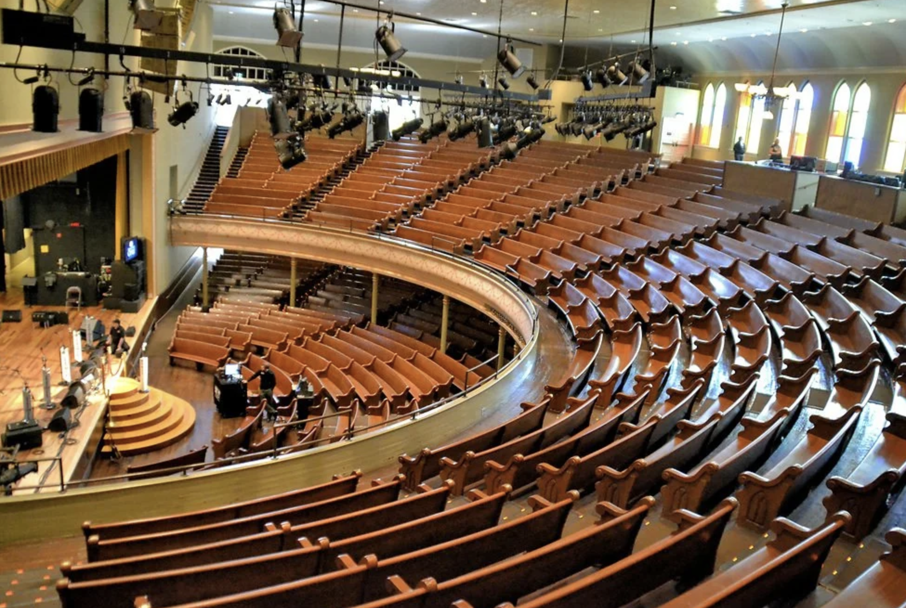
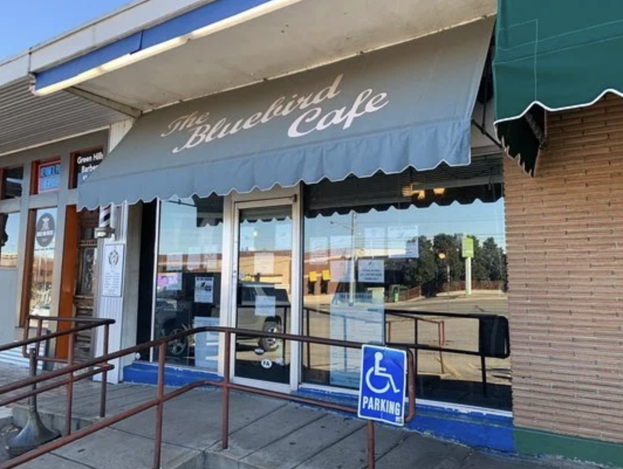
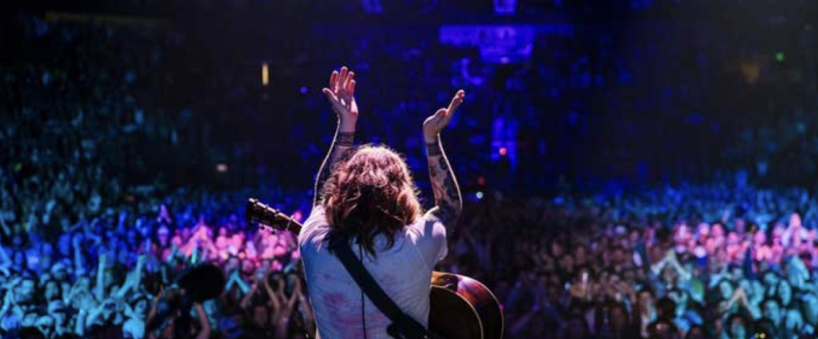
Nashville Entertainment Cluster
Turning Music City into a full-scale cluster for content, live experience, production, technology, talent, and intellectual property.
Nashville Zone 5
Notes:
Growth with a Soul
Growth of the Soul
How to fully integrate the Soul

Slide 2
Value Proposition
Nashville is uniquely positioned to lead the nation's creative economy through a vertically integrated music and entertainment ecosystem with the technology and entrepreneurial spirit that turns creativity into companies, careers, and economic growth.

Slide 3

1. REGION
Differentiation
80% of the U.S. country music business headquarters
25% of all U.S. music publishers are based in Tennessee
~ 17 million tourists including 500,000 international
The highest concentration of music industry employment in the nation.
250 music and entertainment venues (6x Japan and NYC per capita)
~80,000 jobs $10 Billion Economic Impact
Highest concentration of music industry employment in the nation
10x New York City
1
Region
2
Cluster
3
Priority
4
Execution
5
Future
Notes:
What is your VALUE PROPOSITION based on UNIQUE STRENGTHS and DIFFERENTIATION? - Gerald
Make the case that Middle Tennessee can compete in a way others cannot easily copy.
Avoid reducing the strategy to Broadway tourism or country music alone; the differentiator is the broader ecosystem.
A full creative value chain already exists: creators, venues, publishers, production suppliers, professional services, sports, tourism, and media talent.
AI, streaming, rights tracking, fan analytics, and virtual production create urgency to own more IP and company value locally.
By almost any measure, Nashville is one of the most concentrated music-industry hubs in the world.
Here are some useful ways to think about it:
Music publishing: More than 25% of all U.S. music publishers are based in Tennessee, almost all of them in the Nashville area.
Country music: Nashville is the unquestioned center of the industry. An estimated 80–90% of the U.S. country music business—artists, labels, publishers, songwriters, producers, and related services—is located there.
Overall U.S. music business: Nashville is generally considered the third-largest music industry hub after Los Angeles and New York City. It is especially dominant in publishing, songwriting, artist management, Christian music, and music licensing.
Employment concentration: While Nashville does not have the largest absolute number of music jobs (Los Angeles and New York do), it has the highest concentration of music industry employment in the nation. Some studies estimate its music industry concentration is 10 times greater than New York’s and as much as 30 times the U.S. average.
The local economic impact is also remarkable:
Approximately 41,000 direct music and entertainment jobs in the Nashville metropolitan area.
Roughly 80,000 total jobs when indirect and induced effects are included.
Around $8.6–10 billion in annual economic impact for the region.
In practical terms
If you’re talking about:
Country music: Nashville accounts for well over three-quarters of the industry’s business infrastructure.
The entire U.S. music industry: Nashville probably represents only a single-digit percentage of total U.S. music employment and revenue because pop, hip-hop, film scoring, streaming, live entertainment, and Latin music are spread across Los Angeles, New York, Atlanta, Miami, and other cities. However, it is far more influential than its size would suggest, particularly because of its dominance in songwriting, publishing, recording, and artist development.
Given your earlier questions about Nashville’s economic development and collaboration, one of the city’s biggest competitive advantages is that the music industry acts as a cluster: labels, publishers, recording studios, producers, musicians, entertainment attorneys, marketing firms, instrument manufacturers, and technology companies are located within a few miles of one another. That dense network creates an outsized influence relative to Nashville’s population.
Home of 80%+ of the U.S. country music business—artists, labels, publishers, songwriters, producers, and related services—is located there.
Employment
Perf Arts 30K
Hosp & Tourism 30K
Music & Recording 10K
Video 5K
total - 75K
Job Creation Music Recording 5K
Perf Arts 10K
Hosp & Tourism 10K
Video 5K
Total 30K

Slide 4
Nashville Entertainment Cluster Ecosystem
Pop
Latin
Christian Gospel Church
Authors
Indigenous
Rock
Actors
Policy Makers
Symphony
Americana
Tourism
Singers
TV / Film
Rap / Hip-Hop
Visual Artists
Gaps:
Afford.housing/cost of living
Wages below avg.
Public transportation
Workforce deficiencies
Connection across sectors
Health Care for Creatives
Opera
Country
Musicians
Bluegrass
Business Managers
Lawyers
Vinyl Record Manufacturing
Music
Songwriters
Supporting Ecosystem
Creators
Concert Promoters
Booking Agents
Radio
Artist Managers
Digital Streaming Platforms (DSPs)
Bankers
Radio Distribution
Industry
Producers
Publishers Song Publishers
SiriusXM
Creative Entertainment Cluster
Distributors
Arenas
Labels
Outdoor Parks
Venues Events
Technology Services
Other Venue Crew
Merchandise Companies
Video Companies
Stagehands
Theatres
Festivals
Nonprofit Industry Associations
Education
Music Technology Companies
Staging Companies
Bus Companies
Culture
Trucking Companies
Lighting Companies
Stadiums
Vanderbilt University
Clubs / Bars
MLC
TSU
AMA
Audio Companies
ACM
Leadership Music
Frist Art Museum
Art Galleries
Lipscomb University
Touring Crew
CMA
TPAC
Nashville Shakespeare Festival
Belmont University
IEBA
Country Music Hall of Fame & Museum
National Museum of African American Music
Hume-Fogg
Other Educational Institutions
Jefferson Street Sound Museum
RIAA
Labor Unions
MTSU
Fisk University
NSAI
GMA
Nashville Symphony
Grand Ole Opry
Nashville Opera
Notes:
What CLUSTER or CLUSTERS have you decided to leverage or strengthen (What’s the opportunity?) - Sally
Name the opportunity and describe why this cluster is the best starting point for regional action.
Cluster Assets: Music business, live entertainment, sports entertainment, film/video/digital content, podcasting, streaming, creator economy, tourism, conventions, experience design, technology tools, and specialized suppliers.
Cluster Gaps: Coordination across sectors; AI/IP literacy; rights protection; workforce pathways; capital for IP-based and locally headquartered firms; inclusion of Jefferson Street, HBCU-connected talent, and rural creative communities.

Slide 5

3. STRATEGIC PRIORITY
Chosen Priority and Why
Middle Tennessee can lead the Creative Entertainment economy by turning Music City into a full-scale cluster for content, live experience, production, technology, talent, and intellectual property. The strategic shift is from “Come visit Music City” to “Build your company, career, content, technology, production operation, and IP here.”
Evidence 1
Evidence 2
Evidence 3
The ecosystem exists, but music, sports, tourism, film, production, technology, education, and capital are not yet consistently linked as one cluster.
The biggest white spaces are cross-cutting issues: AI/IP, rights, royalties, creative workforce, supplier mapping, inclusive pathways, and aligned capital.
A neutral broker strengthens existing organizations rather than replacing the Chamber, CVB, universities, venues, Music Row groups, or entrepreneur networks.
Avg Local Entertainment and Media income for Nashville Region is below US Avg
2013-20: Economic impact grew 43%, #1 among top us music metro areas for both net job growth and growth rate
Nash already has unusually dense emp. 7.8 music cluster jobs per 1000 jobs (vs 2.8 NY, 2.6 Austin, and 2.0 LA), makes startup support more productive - all allied employers like talent lawyers, studios, venues, etc in very close proximity
Well-established formal talent pipeline in the industry at Belmont, MTSU, Vanderbuilt, TSU, Nashville State, Lipscomb, Fisk
Future
1
Region
2
Cluster
3
Priority
4
Execution
5
Notes:
What STRATEGIC PRIORITY have you chosen and why: Support with 3-5 evidence-based bullet points and examples (Why this is a problem) - Bob
Problem we are trying to solve:
Housing affordability - need 90,000 additional units in Davidson County
wages are below national average
Entertainment cluster workers at risk
Music Census finding…
More Davidson County music/creative worker residents struggle than *Community foundation website
*Avg Local Entertainment and Media income fore Nashville Region is below US Avg
avg 80K yr, need 100K to live comfortably
*2013-20: Nash Music industry econ impact grew 43%, #1 among top us music metro areas for both net job growth and growth rate
*Nash already has unusually dense emp. 7.8 music cluster jobs per 1000 jobs vs 2.8 NY 2.6 Austin 2.0 LA, makes startup support more productive - all allied employers like talent lawyers, studios, venues, etc in very close proximity
*Nash has a well established formal talent pipeline in the industry located at multiple institutions like Belmont, MTSU, Vandy, TSU, Nash St, Lipscomb, Fisk
*

Slide 6


Slide 7
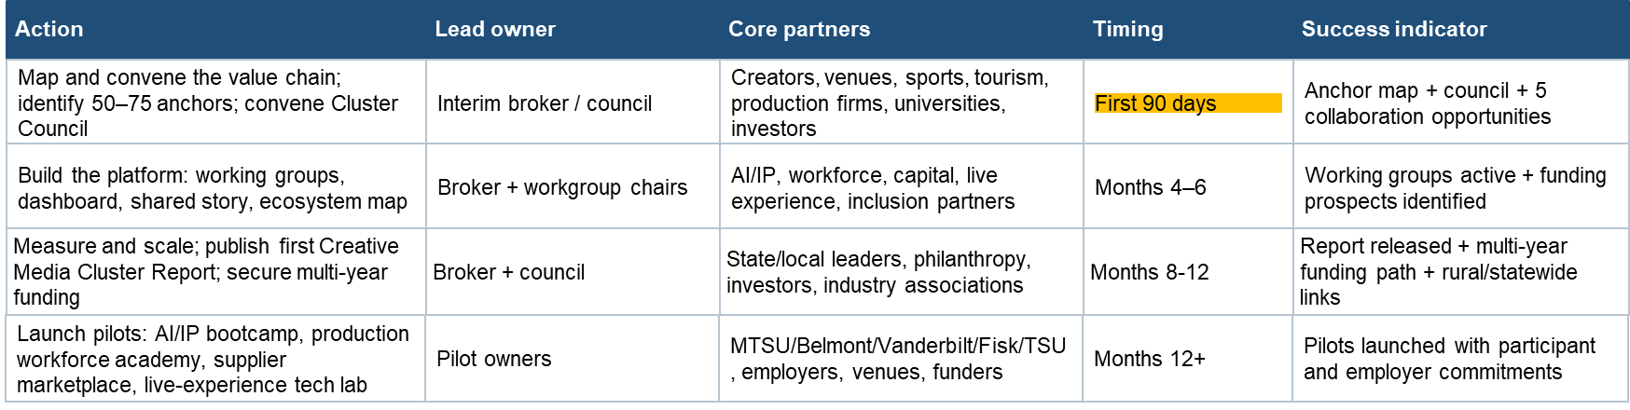
4. EXECUTION
90 Day and 12-Month Plan
1
2
3
4
1. Map
2. Convene
3. Commit
4. Launch
Convene a Council and define the white space, operating principles, and governance.
Launch five working groups: AI/IP, production workforce, creative capital, live experience, and inclusive pathways. Identify initial funding.
Select first pilots, assign owners, and create a simple cluster dashboard.
Map the value chain and identify 50–75 anchor organizations, firms, venues, institutions, and community partners.
Action
Lead owner
Core partners
Timing
Success indicator
Map and convene the value chain; identify 50–75 anchors; convene Cluster Council
Interim broker / council
Creators, venues, sports, tourism, production firms, universities, investors
First 90 days
Anchor map + council + 5 collaboration opportunities
Build the platform: working groups, dashboard, shared story, ecosystem map
Broker + workgroup chairs
AI/IP, workforce, capital, live experience, inclusion partners
Months 4–8
Working groups active + funding prospects identified
Launch pilots: AI/IP bootcamp, production workforce academy, supplier marketplace, live-experience tech lab
Broker + council
MTSU/Belmont/Vanderbilt/Fisk/TSU, employers, venues, funders
Months 8-12
Pilots launched with participant and employer commitments
Measure and scale; publish first Creative Media Cluster Report; secure multi-year funding
Broker + council
State/local leaders, philanthropy, investors, industry associations
Months 12+
Report released + multi-year funding path + rural/statewide links
1
Region
2
Cluster
3
Priority
4
Execution
5
Future
Notes:
Virginia/Al

Slide 8

CLOSE
Looking Ahead
Future-state vision
Nashville is where the World comes to create, produce, protect, finance, stage, and export the next generation of Creative Entertainment and live experiences.
Call to Action
Endorsement of the Creative Entertainment Council
Invitees join an interim Council within 30 days.
Obtain commitments from named partners to five working groups: AI/IP, production workforce, creative capital, live experience, and inclusive pathways.
Industry leaders contribute data, pilot sites, employer needs, funding leads, and public/private champions.
10
1
Region
2
Cluster
3
Priority
4
Execution
5
Future
Notes:
End with the concrete action needed from the room. - Wright
Future Economy: -A cluster where music, media, sports, live entertainment, technology, has been sustained and grown and become more productive, created more content, companies, talent, and cultural influence. -More local creators and companies own the IP and capture more revenue, profit, wages have risen and
Future Talent - Visible pathways for students, career changers, sidelined workers, technicians, editors, stage crews, production managers, designers, coders, logistics workers, and business talent from the appropriately focused local education programs.
Future Place - A fuller regional entertainment story beyond Broadway and country music of today: Jefferson Street history, HBCU-connected and other minority talent, rural music communities, faith-based media, maker communities, tourism, hospitality, and cultural districts. Culture has been sustained. .
“The Soul!!!”
Ask: Create new council? Engage with: Chamber engagement, c leadership TN, Leadership Music
Next meeting / owner
Designate an interim convener before leaving TLAP.
Schedule the first Cluster Council meeting within 30 days.
Use that meeting to confirm scope, governance, first pilots, and funding approach.

Slide 9
Thank You

